Slide 1
Chapter 3
Brownian Motion
報告者：何俊儒

Slide 2
3.1 Introduction
Define Brownian motion
．Provide in section 3.3
Develop its basic properties
．section 3.5-3.7 develop properties of
Brownian motion we shall need later

Slide 3
The most important properties of Brownian motion
It is a martingale
It accumulates quadratic variation at rate one per unit time

Slide 4
3.2 Scaled Random Walks
3.2.1 Symmetric Random Walk
3.2.2 Increments of the Symmetric
Random Walk
3.2.3 Martingale Property for the
Symmetric Random Walk
3.2.4 Quadratic Variation of the Symmetric
Random Walk

Slide 5
3.2 Scaled Random Walks
3.2.5 Scaled Symmetric Random Walk
3.2.6 Limiting Distribution of the Scaled
Random Walk
3.2.7 Log-Normal Distribution as the Limit
of the Binomial Model

Slide 6
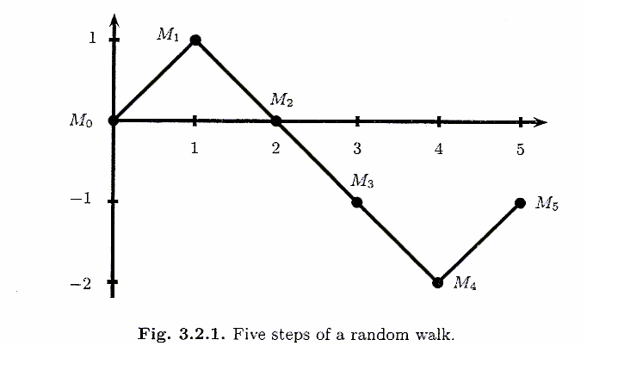
3.2.1 Symmetric Random Walk
To create a Brownian motion, we begin with a symmetric random walk, one path of which is shown in Figure 3.2.1.

Slide 7
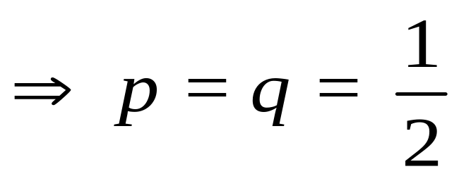
Construct a symmetric random walk
Repeatedly toss a fair coin
．p, the probability of H on each toss
．q = 1 – p, the probability of T on each
toss
Because the fair coin

Slide 8
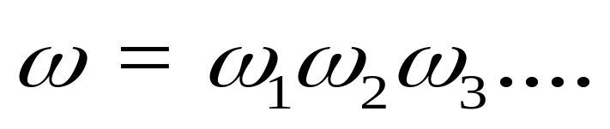

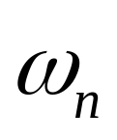
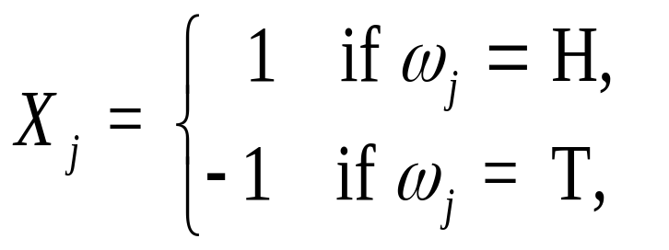
Denote the successive outcomes of the tosses by
is the infinite sequence of tosses
is the outcome of the nth toss
Let

Slide 9
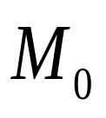
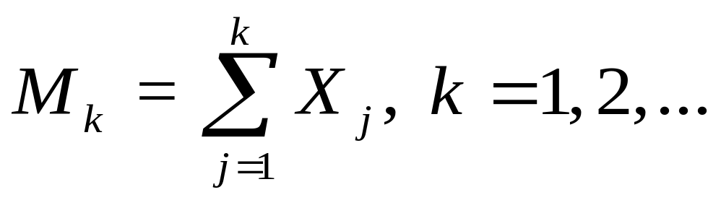

Define = 0,
The process , k = 0,1,2,…is a symmetric random walk
With each toss, it either steps up one unit or down one unit, and each of the two probabilities is equally likely

Slide 10
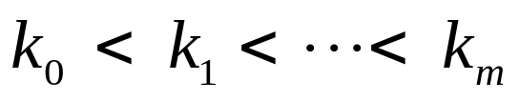
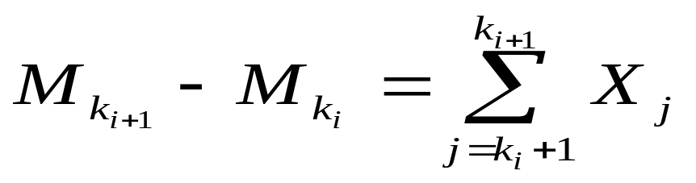
3.2.2 Increments of the Symmetric
Random Walk
A random walk has independent increments
．If we choose nonnegative integers
0 = , the random variables
are independent
Each of these rvs.
is called an increment of the random walk

Slide 11
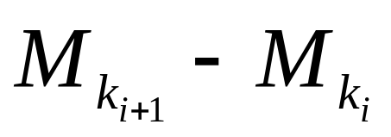
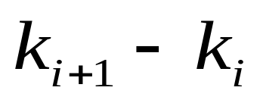
Increments over nonoverlapping time intervals are independent because they depend on different coin tosses
Each increment has expected value 0 and variance

Slide 12
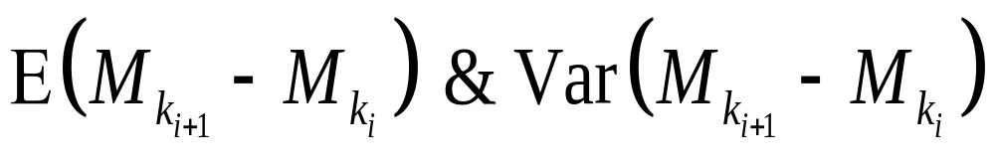
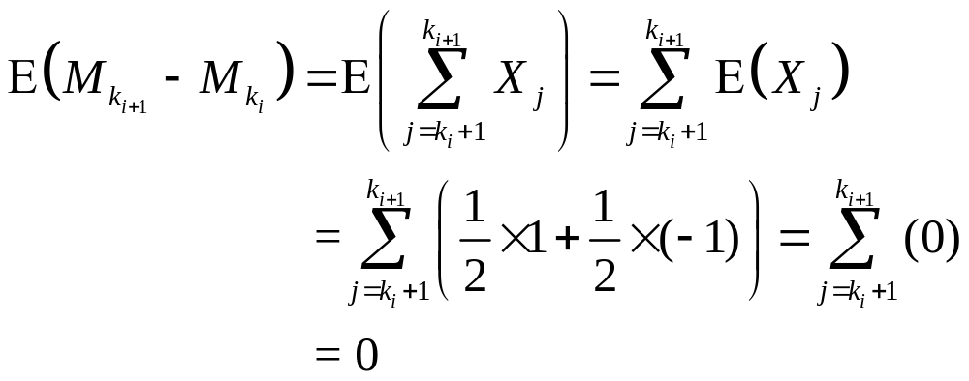
Proof of the

Slide 13
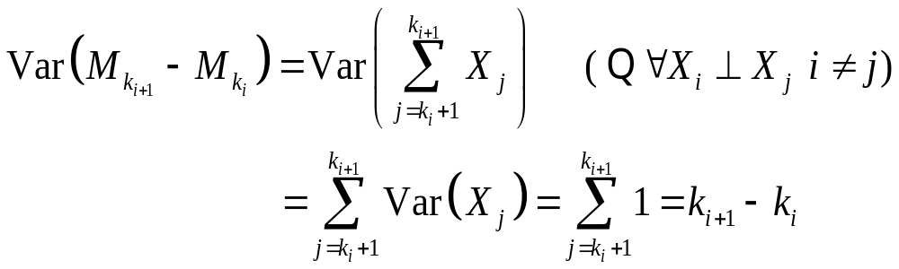
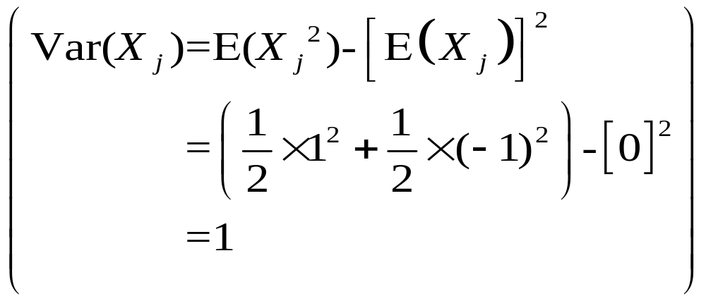
Proof of the

Slide 14
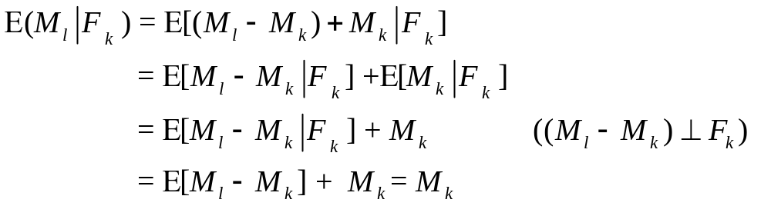
3.2.3 Martingale Property for the
Symmetric Random Walk
To see that the symmetric random walk is a martingale, we choose nonnegative integers k < l and compute

Slide 15
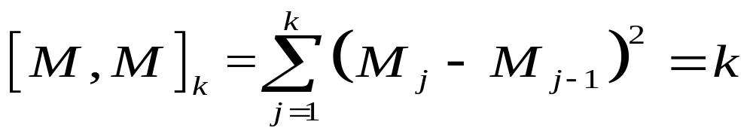
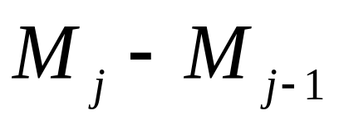
3.2.4 Quadratic Variation of the
Symmetric Random Walk
The quadratic variation up to time k is defined to be
Note :
．this is computed path-by-path and
．by taking all the one-step increments
along that path, squaring
these increments, and then summing them
(3.2.6)

Slide 16
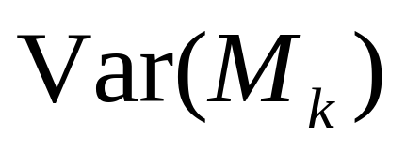
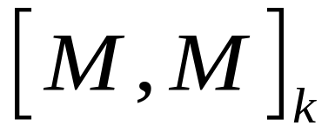
How to compute the
Note that is the same as , but the computations of these two quantities are quite different
is computed by taking an average over all paths, taking their probabilities into account
If the random walk were not symmetric, this would affect

Slide 17
How to compute the
is computed along a single path
Probabilities of up and down steps don’t enter the computation

Slide 18
The difference between computing variance and quadratic variation
Compute the variance of a random walk only theoretically because it requires an average over all paths
From tick-by-tick price data, one can compute the quadratic variation along the realized path rather explicitly

Slide 19
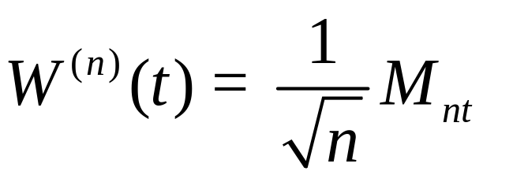
3.2.5 Scaled Symmetric Random
Walk
To approximate a Brownian motion, we speed up time and scale down the step size of a symmetric random walk
We fix a positive integer n and define the scaled symmetric random walk
(3.2.7)

Slide 20
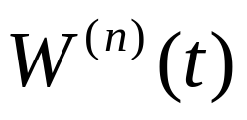

Note
nt is an integer
If nt isn’t an integer, we define
by linear interpolation between its value at the nearest points s and u to the left and right of t for which ns and nu are integers
Obtain a Brownian motion in the limit
as

Slide 21
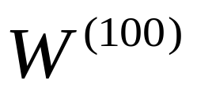
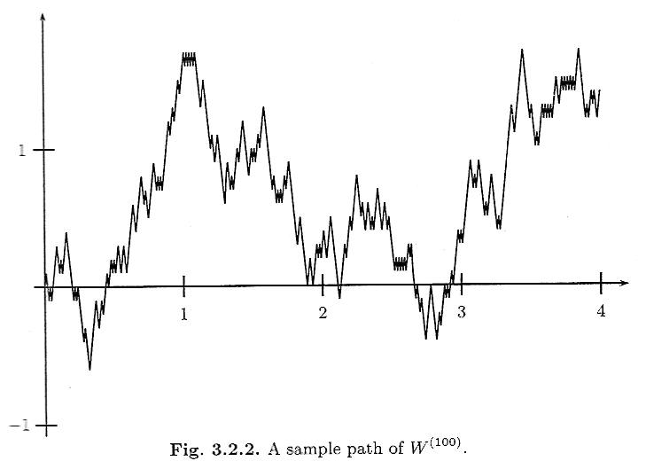
Figure 3.2.2 shows a simulated path of
up to time 4; this was generated by 400 coin tosses with a step up or down of size 1/10 on each coin toss

Slide 22
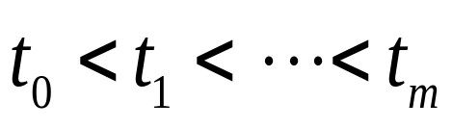
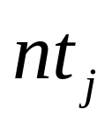
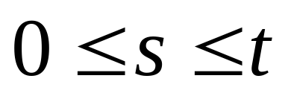
The scaled random walk has independent increments
If 0 = are such that each
is an integer, then
are independent
If are such that ns and nt are integers, then

Slide 23

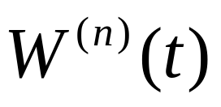
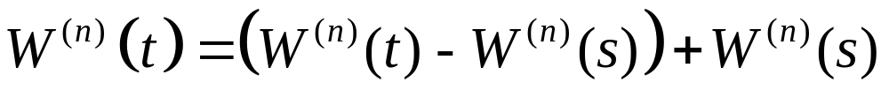
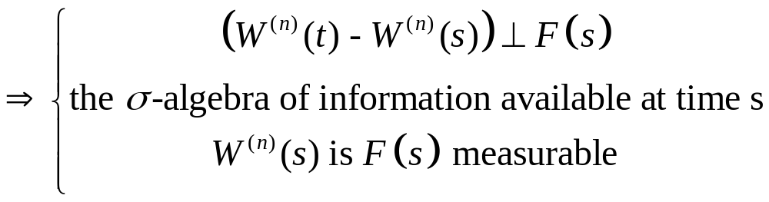
Let be given, and decompose
as
If s and t are chosen so that ns and nt are integers

Slide 24
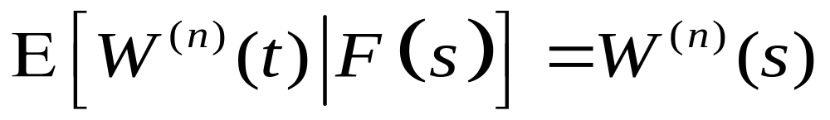
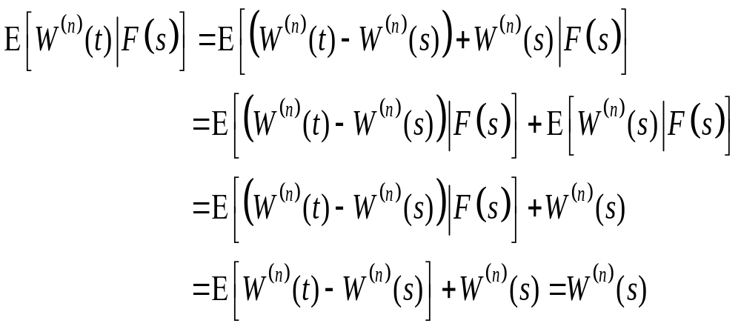
Prove the martingale property for scaled random walk
Proof:

Slide 25
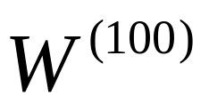
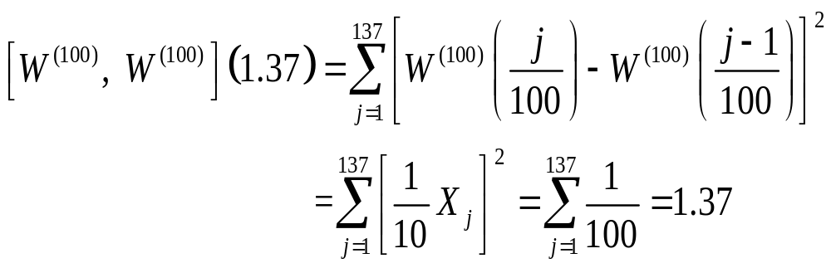
An example of the quadratic variation of the scaled random walk
For the quadratic variation up to a time, say 1.37, is defined to be

Slide 26
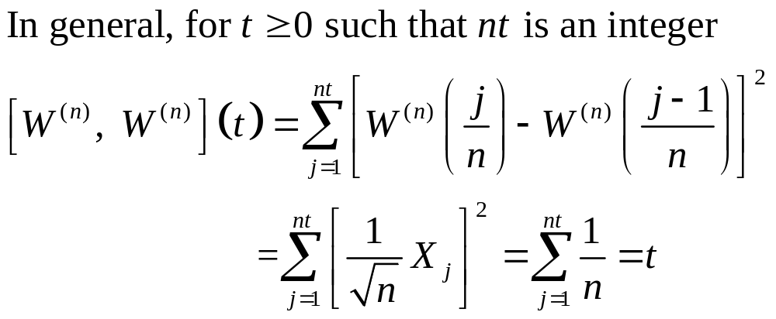

Slide 27

3.2.6 Limiting Distribution of the
Scaled Random Walk
We have fixed a sequence of coin tosses
and drawn the path of the resulting process as time t varies
Another way to think about the scaled random walk is to fix the time t and consider the set of all possible paths evaluated at that time t
We can fix t and think about the scaled random walk corresponding to different values of , the sequence of coin tosses

Slide 28
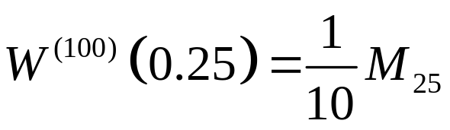
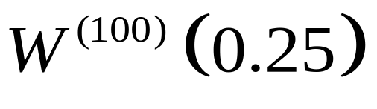
Example
Set t = 0.25 and consider the set of possible values of
This r.v. is generated by 25 coin tosses, and the unscaled random walk can take the value of any odd integer between -25 and 25, the scaled random walk
can take any of the values
-2.5,-2.3,…,-0.3,-0.1,0.1,0.3,…2.3,2.5

Slide 29
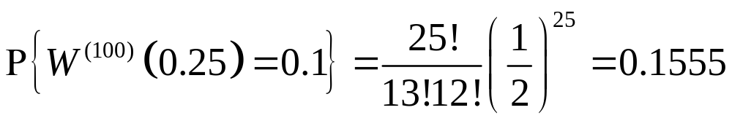
In order for to take value 0.1, we must get 13H and 12T in the 25 coin tosses
The probability of this is
We plot this information in Figure 3.2.3 by drawing a histogram bar centered at 0.1 with area 0.1555

Slide 30
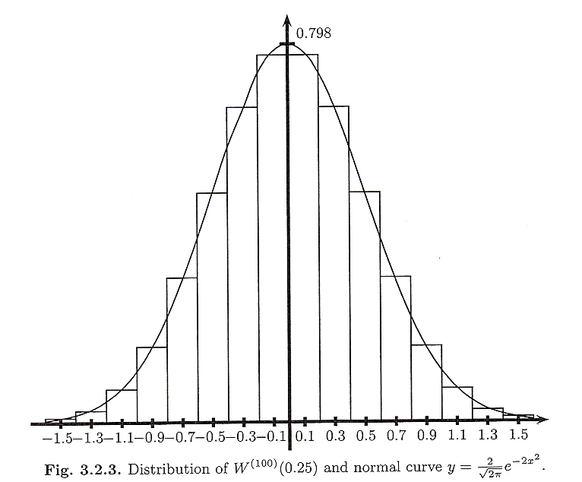
The bar has width 0.2, its height must be 0.1555 / 0.2 = 0.7775

Slide 31
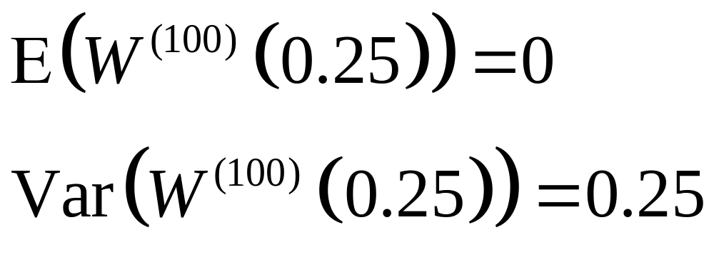
The limiting distribution of
Superimposed on histogram in Figure 3.2.3 is the normal density with mean = 0 and variance = 0.25
We see that the distribution of
is nearly normal

Slide 32
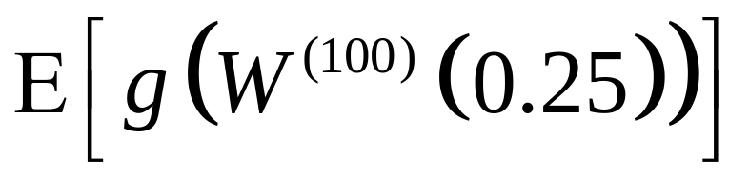
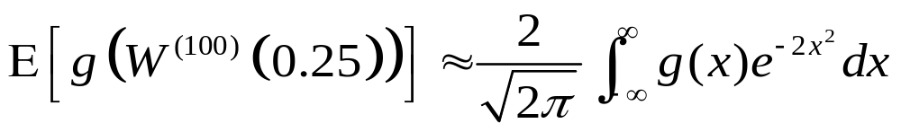
Given a continuous bounded function g(x)
Asked to compute
We can obtain a good approximation
The Central Limit Theorem asserts that the approximation in (3.2.12) is valid
(3.2.12)

Slide 33
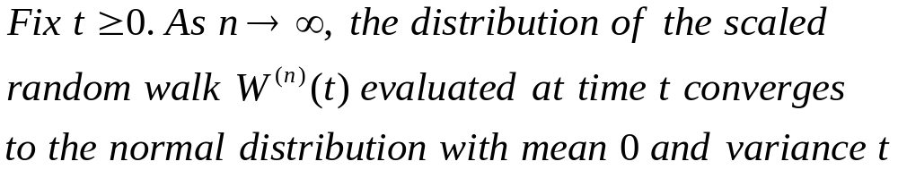
Theorem 3.2.1 (Central limit)
Outline of proof:
藉由MGF的唯一性來判斷r.v.屬於何種分配

Slide 34
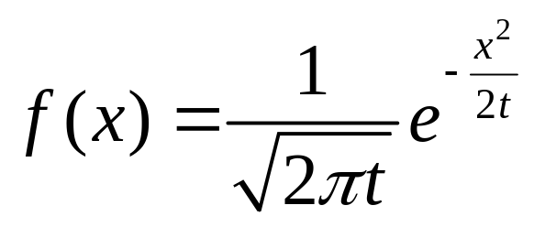
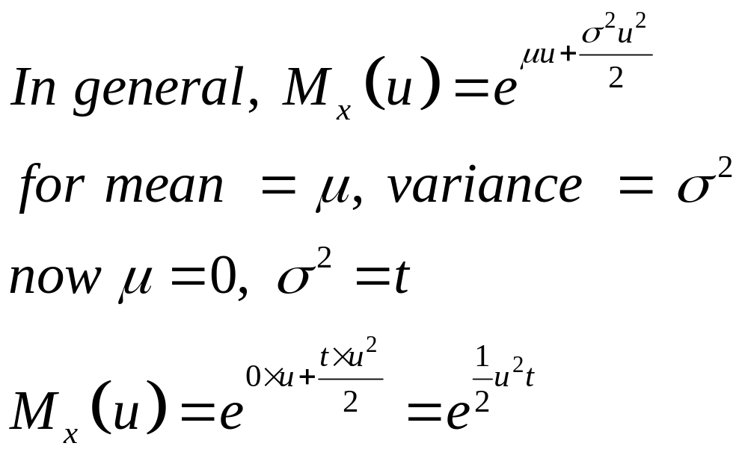
For the normal density f(x) with E(x) = 0, Var(x) = t
(3.2.13)

Slide 35
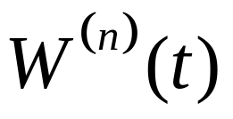
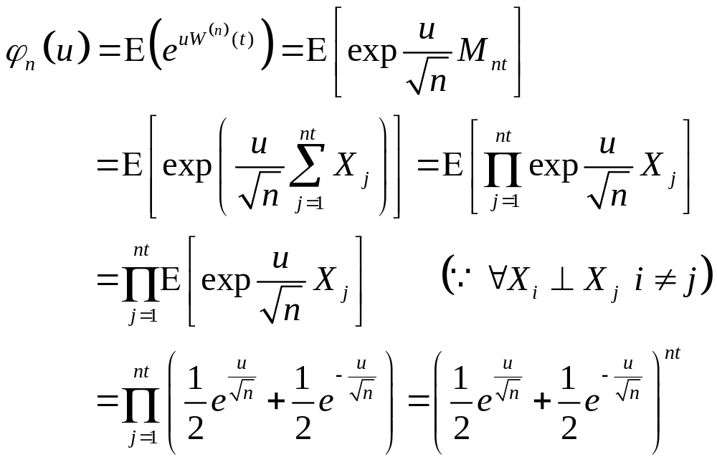
If t is such that nt is an integer, then the m.g.f. for is

Slide 36
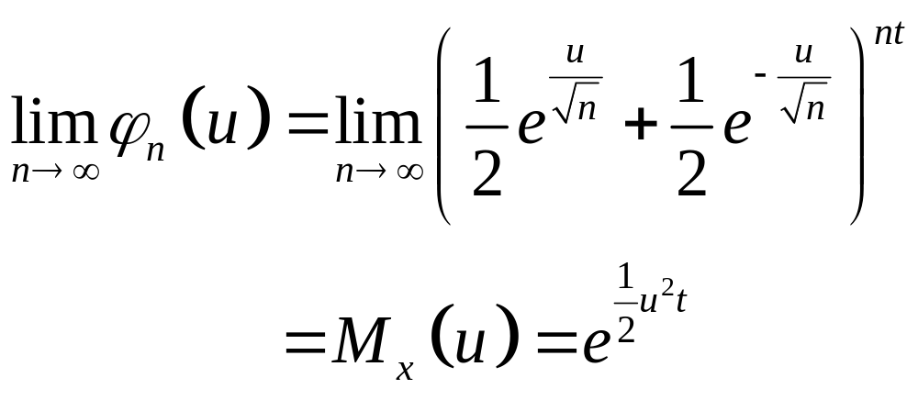
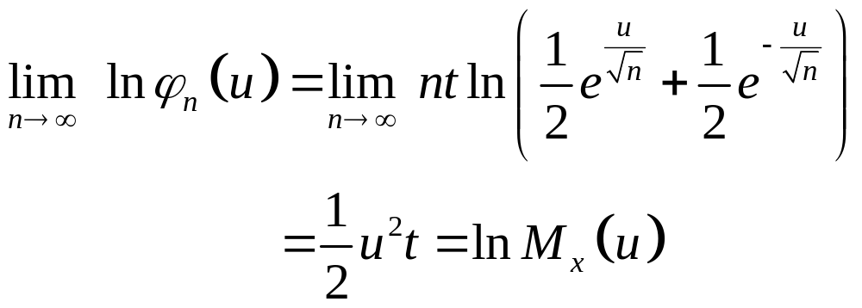
To show that
Proof:

Slide 37
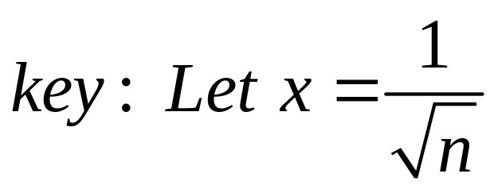


Slide 38
3.2.7 Log-Normal Distribution as the Limit of the Binomial Model
The limit of a properly scaled binomial asset-pricing model leads to a stock price with a log-normal distribution
Present this limiting argument here under the assumption that the interest rate r is 0
Results show that the binomial model is a discrete-time version of geometric Brownian motion model

Slide 39



Let us build a model for a stock price on the time interval from 0 to t by choosing an integer n and constructing a binomial model for the stock price that takes n steps per unit time
Assume that n and t are chosen so that nt is an integer
Up factor to be
Down factor to be
is a positive constant

Slide 40

The risk-neutral probability
See (1.1.8) of Chapter 1 of Volume I

Slide 41



The stock price at time t is determined by the initial stock price S(0) and the result of first nt coin tosses
: the sum of the number of heads
: the sum of the number of tails

Slide 42


The random walk is the number of heads minus the number of tails in these nt coin tosses

Slide 43



求 的極限分配
(3.2.15)
To identify the distribution of this r.v. as

Slide 44

Theorem 3.2.2

Slide 45

Proof of theorem 3.2.2
(3.2.17)

Slide 46

Review of Taylor series expansion

Slide 47


Slide 48




By CLT is a normal distribution
and converge to
with r.v.

